Slide 1

Product Vision Deck
Notes:
Avi: What if your fitness journey wasn’t just another app—but instead a coach, a motivator, and a community, all tailored to you? At Peak Potential, we’re leveraging advanced technology, psychology, and creativity to create a fitness experience that adapts, evolves, and challenges you like never before. We make staying active engaging and effective. And Today we are going to walk through out product —let’s get started."

Slide 2






Meet the Team
Arjun Gupta
Aly
Maknojia
Avi
Bedi
Claudia Benites
Ziduo(Alex)
Sui
Roy
Xiong
COO
CTO
CEO
CMO
CFO
CPO
Notes:
Arjun - Operations
Aly - Technology
Avi - Executive
Claudia - Marketing
Alex - Information
Roy - Product

Slide 3


Vision
Challenge:
Maintaining a consistent gym schedule is difficult for college students and young professionals
Goal:
Fitness accountability app for college students and young professionals, leveraging science to simplify and maintain gym habits
Use gamification, motivational quotes, and community support for positive reinforcement to sustain exercise habits
Notes:
Arjun: Vision Statement:

Slide 4


Target
Customer
Pain Points
Inconsistent gym attendance due to lack of motivation.
Difficulty tracking progress, leading to loss of motivation.
Overwhelming fitness content making it hard to know where to start.
Lack of accountability, making it easier to skip workouts.
Ian
(College Student)
Emily
(Young Professional)
"I don't wanna get too big"
"My main goal is to actually go to the gym"
Notes:
Claudia: Our target customers are individuals who struggle with maintaining fitness consistency, specifically college students and young professionals. Through research, we identified two key personas: Ian and Emily. Ian is a college student who wants to stay consistent with his gym routine but finds it challenging due to fluctuating academic and social schedules. He needs a solution that provides tracking, motivation, and a supportive community to keep him accountable. Emily, a young professional, wants to stay active but often postpones going to the gym because she finds it overwhelming to start and maintain a routine. She lacks structured guidance and needs flexibility, reminders, and accountability to stay engaged. The main pain points we've identified include inconsistent gym attendance due to busy schedules, difficulty tracking progress which leads to a loss of motivation, and an overwhelming amount of fitness content that makes it hard to know where to start. Additionally, without accountability, it becomes too easy to skip workouts. These insights are crucial because they highlight the gaps in existing fitness solutions and show where Peak Potential can provide real value.
MAYBE SOME SPECIFIC PSYCHOGRAPHICS THAT WE CAN MENTION

Slide 5
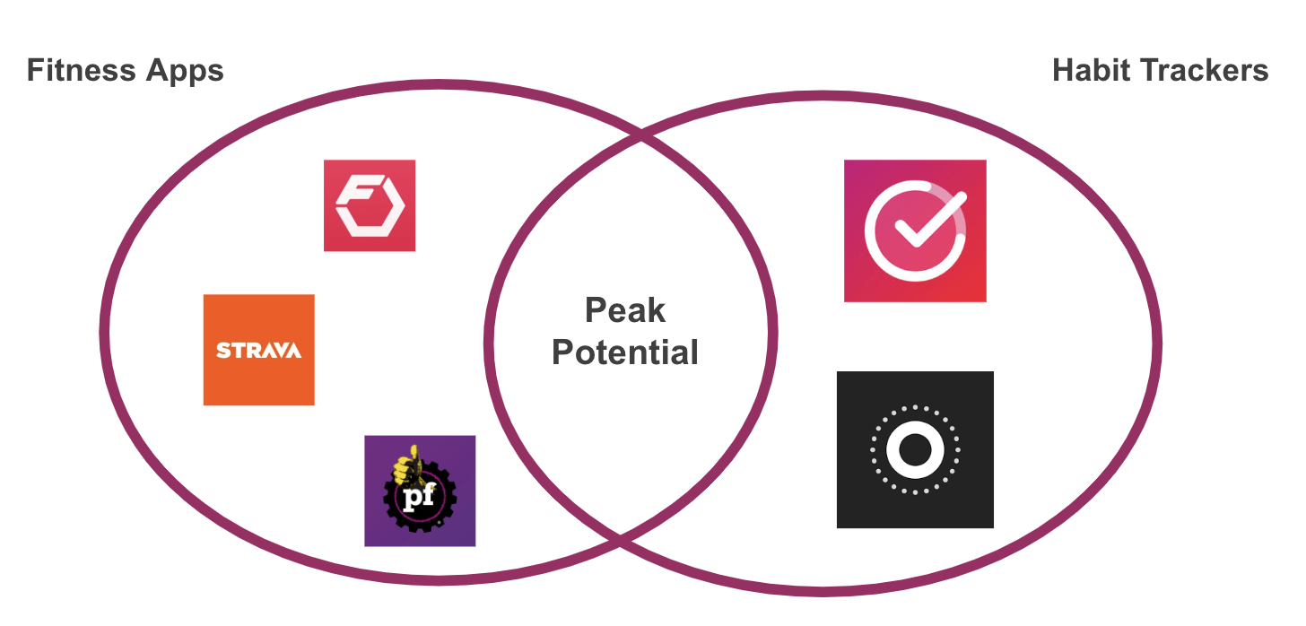
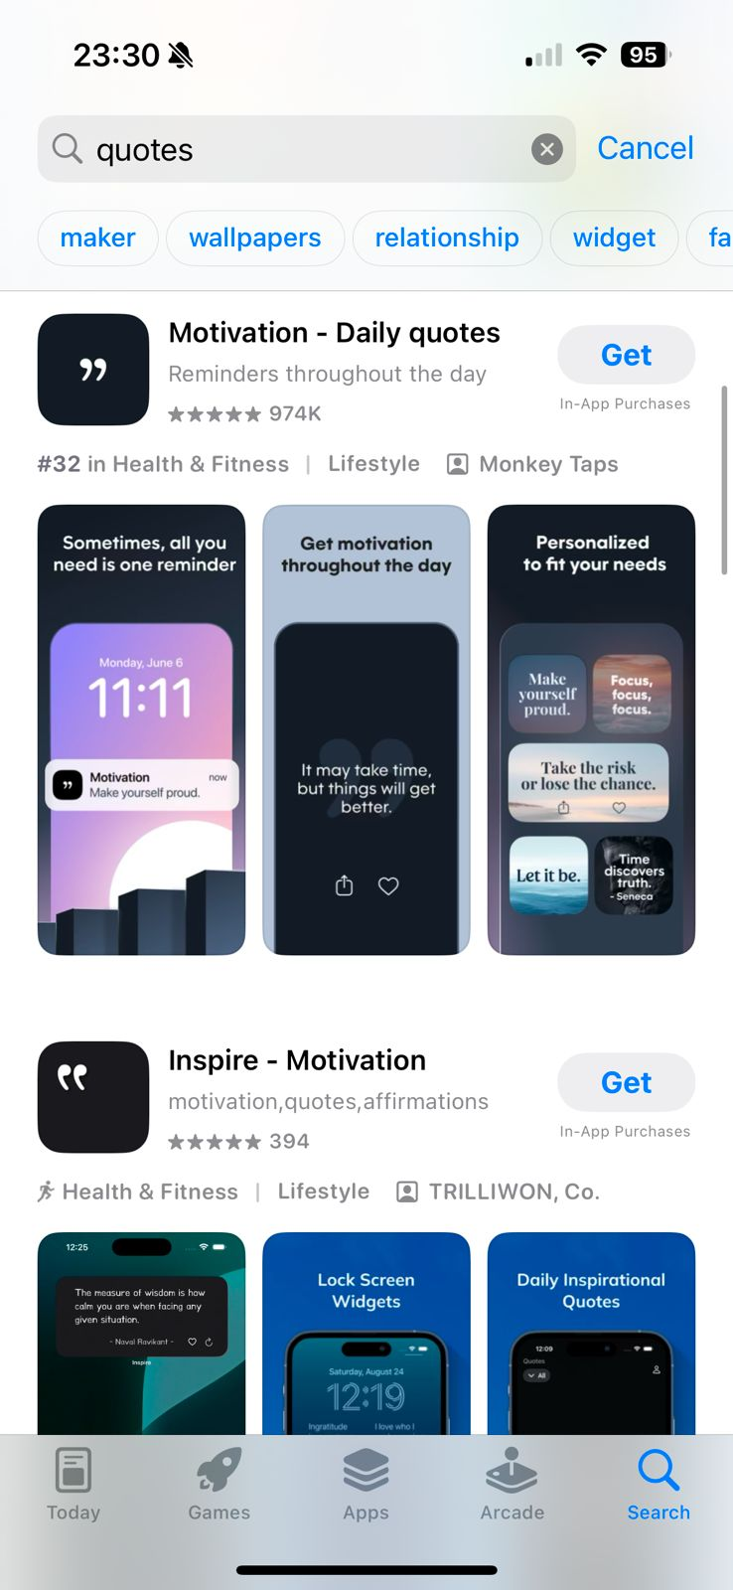
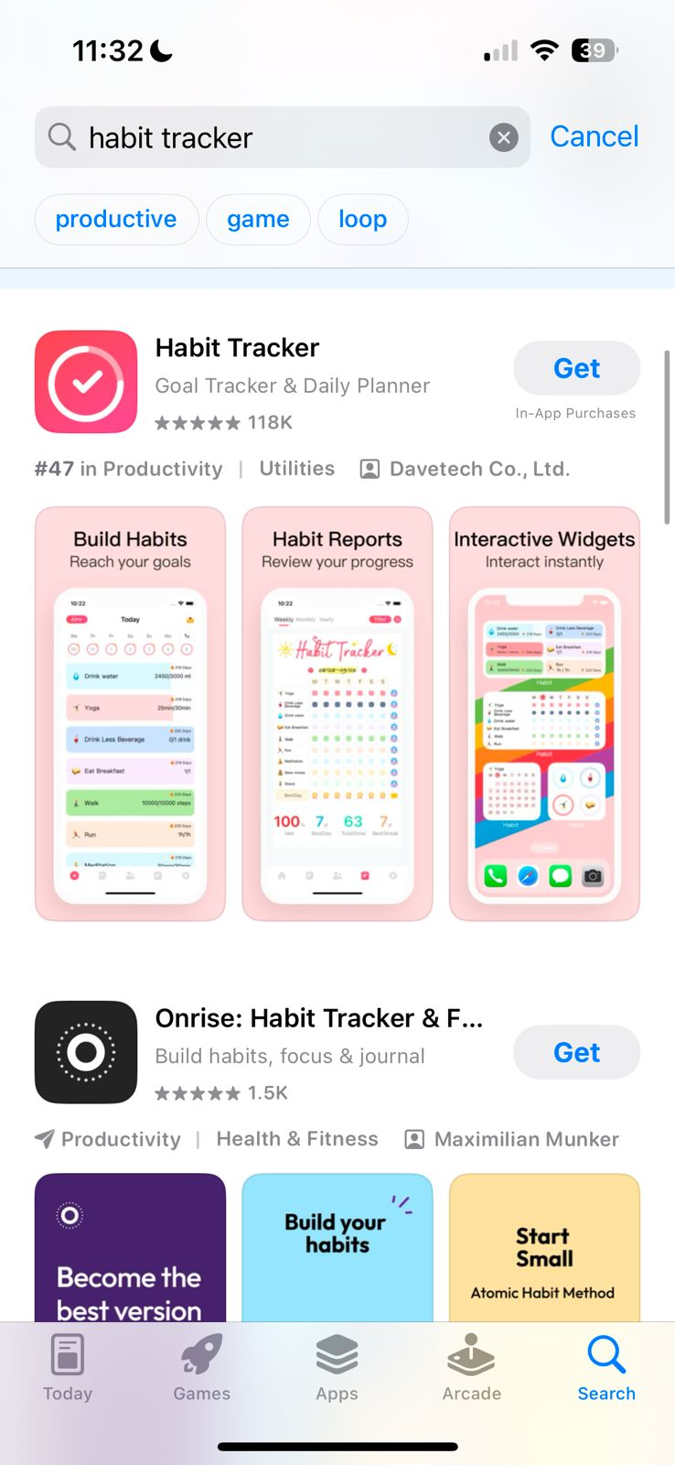
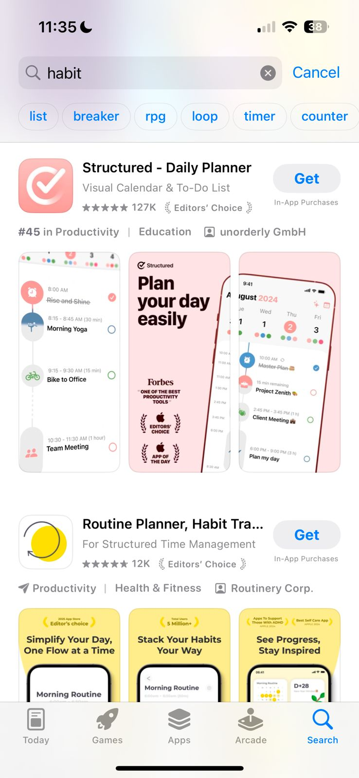
Current Solutions & Our Product
Current Solutions & Gaps
Fitness Apps (MyFitnessPal, Fitbod, Strava) – No habit-building or accountability
Manual Tracking – Tedious & inconsistent
Friends for Motivation – Unreliable & inconsistent
How Peak Potential is Different
Habit-Building – Gamified challenges & consistency tracking
Effortless Tracking – Simple UI, no manual logging
Community Support – Social motivation & group challenges
Positive Reinforcement – Motivational quotes & progress updates
Notes:
Ruoyu: Many fitness solutions exist, but they all have major gaps. Fitness apps like MyFitnessPal, Fitbod, and Strava focus on tracking but don’t help with habit-building or accountability. Manual tracking is tedious and inconsistent, making it easy to give up. Friends for motivation can help, but their support is often unreliable.
This is where Peak Potential stands out. We focus on habit-building through gamified challenges and consistency tracking. Our effortless tracking feature removes the need for manual logging with a simple, user-friendly interface. Community support keeps users motivated through social engagement and group challenges. Lastly, positive reinforcement provides motivational quotes and progress updates to encourage consistency.
As shown in the diagram, Peak Potential bridges the gap between fitness apps and habit trackers, offering a complete solution that not only tracks progress but helps users build lasting fitness habits.

Slide 6
Product Demo
Marvel Link
Notes:
Claudia:

Slide 7
Market Size
Global Population of Young People Aged 15-24: ~1.2 Billion
Assumption: 10% engage in digital fitness, average annual spend is $60-100
1.2 Billion x 10% x $60-100 = ~$10 Billion
1
TAM
US Population of Young People Aged 15-24: ~36 Million
Assumption: 50% of these young people are interested in digital fitness, average annual spend is $80-120
36 Million x 50% x $80-120 = ~$1.8 Billion
2
SAM
Chicagoland Young People Aged 15-24: ~3% of US Population
Assumption: Peak Potential starts its service within Chicagoland, and can obtain about 10% of the digital fitness market
3
SOM
$1.8 Billion x 3% x 10% = ~$5.4 Million
Notes:
Let’s walk through our market size estimates. First, for the TAM, we start with 1.2 billion young people worldwide aged 15 to 24. We assume 10% engage in digital fitness, and that each spends about 60 to 100 dollars annually. This gives us a TAM of around 10 billion dollars.
Next, we narrow down to the SAM, focusing on the U.S. The U.S. has roughly 36 million young people aged 15 to 24. We assume half are interested in fitness—based on data showing 37% view exercise as a social activity (https://www.tggplc.com/news-and-media/press-releases/fitness-and-friendship-combine-for-gen-z-as-more-than-a-third-view-working-out-as-a-way-to-socialise), and accounting for those who may not see it that way but still work out. Given their slightly higher spending power of 80 to 120 dollars per year, the SAM comes to about 1.8 billion dollars.
Finally, for the SOM, we look at the Chicagoland area. We estimate a 10% market share based on market share data from Statista (https://www.statista.com/chart/30109/fitness-app-penetration-rate-and-market-share-united-states/). The population of Chicagoland is about 3% of the US, translating to around 5.4 million dollars in potential revenuez

Slide 8
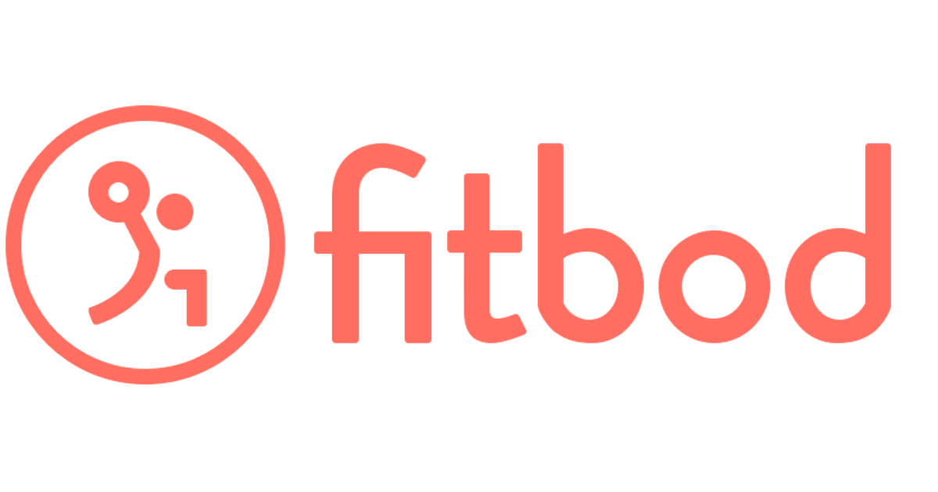
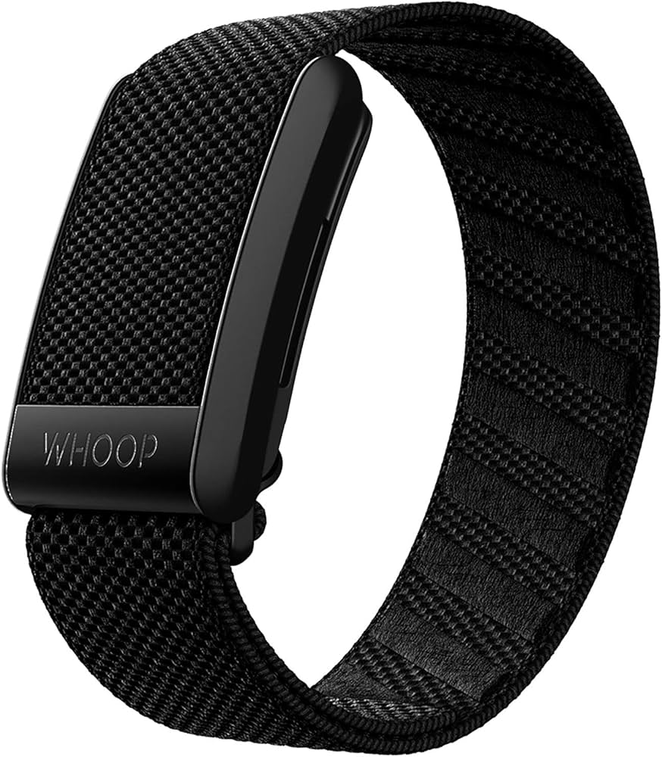
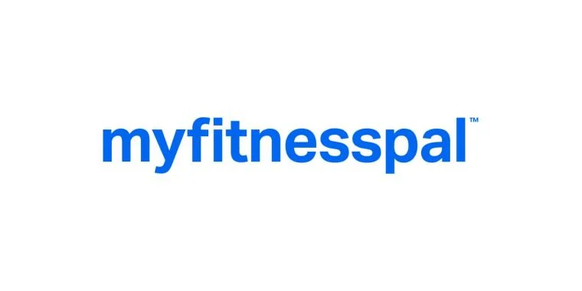
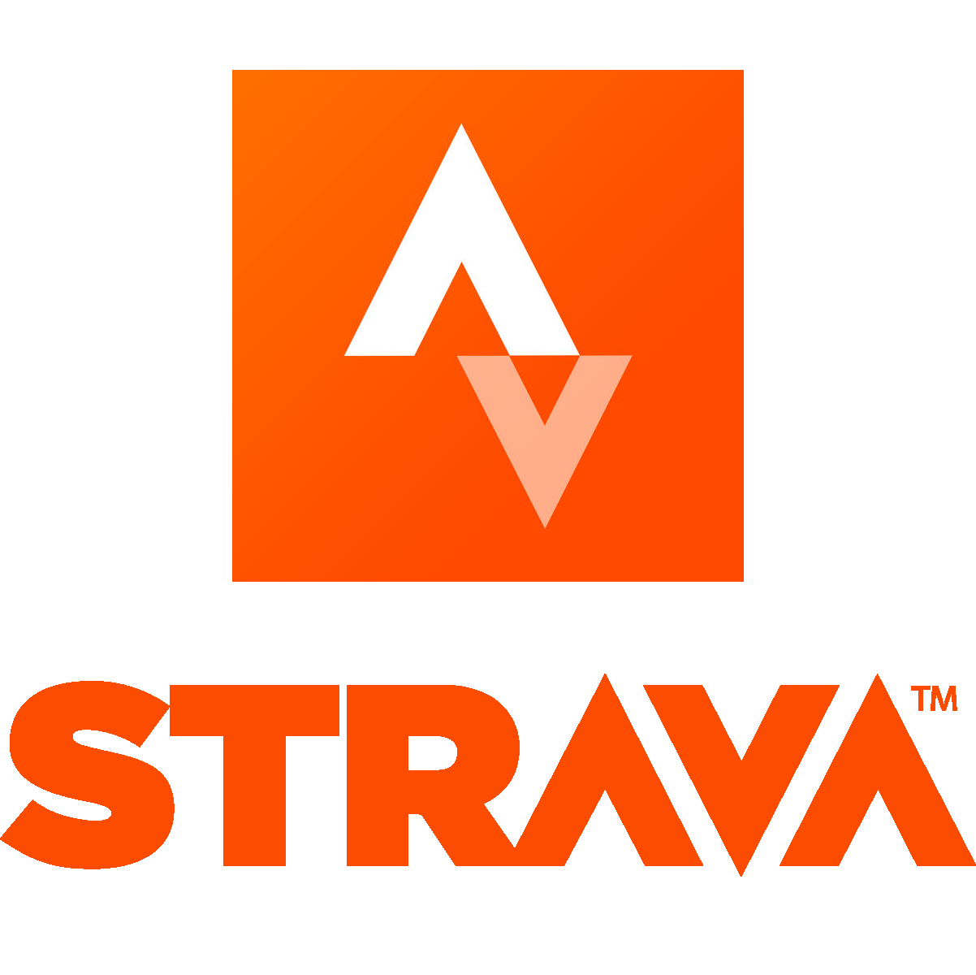
Unit Economics
‹#›
Revenue Model & Pricing:
Subscription-Based model
Incentivizes users to stay engaged
Proven success in Fitness & Wellness Market
Freemium Model: Free tier with premium features
Low barrier to entry, reducing friction in adoption
Projected Pricing
Free tier: Limited features
Premium: $14.99/month or $125/year
Combine multiple services into one at lower cost
Notes:
Aly: Our revenue model follows a freemium approach, offering a free tier with limited features and a premium subscription at $14.99/month or $125/year, unlocking personalized coaching, advanced analytics, and habit-building tools. We aim for 3,000 signups in 3 months and 10,000+ in year one, with an activation rate of 50% completing their first workout plan in 7 days, increasing to 65% by month 6. Retention is a key focus, targeting 40% (30-day) and 25% (90-day) retention at launch, improving to 50% and 35% within a year. We project a 5% churn rate initially, reducing to 3% by month 9, with an ARPU of $6 at launch, growing to $8 by year one. Our LTV:CAC ratio starts at 3:1, reaching 4:1 by year two, with CAC dropping from $50 to $35. Workout completion is expected to hit 60% logging 3+ workouts per week by month 3, and 70% by month 9, while referral signups grow from 20% to 35% in a year. We anticipate breaking even in year two by increasing engagement, retention, and referrals while optimizing user value and acquisition costs, positioning Peak Potential as a sustainable leader in fitness technology.

Slide 9
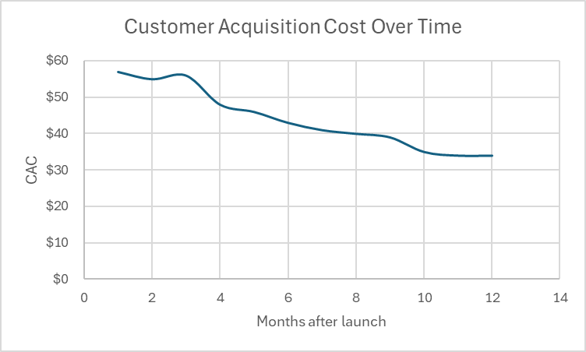
Unit Economics
‹#›
Customer Acquisition Cost (CAC): | $~30 per user after 12 months of launch and after 2 years $15-$20 per user
Lifetime Value (LTV): | Expected customer retention: 12-24 months → Estimated LTV: $180 - $300
Cost of Service (COS): | Cloud Hosting (AWS/Azure), Data & AI Processing Costs, Support & Customer Service, App Store Fees. $3-$7 per user/month
LTV:CAC Ratio | 3:1 Initially -> 9:1 after 2 years
Notes:
Aly: Our revenue model follows a freemium approach, offering a free tier with limited features and a premium subscription at $14.99/month or $125/year, unlocking personalized coaching, advanced analytics, and habit-building tools. We aim for 3,000 signups in 3 months and 10,000+ in year one, with an activation rate of 50% completing their first workout plan in 7 days, increasing to 65% by month 6. Retention is a key focus, targeting 40% (30-day) and 25% (90-day) retention at launch, improving to 50% and 35% within a year. We project a 5% churn rate initially, reducing to 3% by month 9, with an ARPU of $6 at launch, growing to $8 by year one. Our LTV:CAC ratio starts at 3:1, reaching 4:1 by year two, with CAC dropping from $50 to $35. Workout completion is expected to hit 60% logging 3+ workouts per week by month 3, and 70% by month 9, while referral signups grow from 20% to 35% in a year. We anticipate breaking even in year two by increasing engagement, retention, and referrals while optimizing user value and acquisition costs, positioning Peak Potential as a sustainable leader in fitness technology.

Slide 10
Key Metrics
‹#›
Metric Name | Definition | How It’s Measured & How Often | Hypothesis (Initial Targets) / Success
Activation Rate | % of signups who complete their first workout plan | (Activated Users/ Signups) * 100 per week | 50% activation within 7 days
Engagement Rate | % of signups who engage with photos (post, likes, share, etc). | (# of users engaging with memories feature 3+ times per week/ Signups) * 100 per week | 70% engagement within 7 days
Churn Rate | % of paying users who cancel per month | (Lost subscribers / total subscribers) * 100 per month | 5% monthly churn at launch, reducing to 3% by Month 9
Avg. Revenue Per User (ARPU) | Total revenue / total users | Subscription revenue ÷ user base per month | $6 per user by Month 3, increasing to $8 by Month 12
Workout Completion Rate | % of users who log workouts weekly | (# of users completing 3+ workouts per week) ÷ total active users per week | 60% by Month 3, rising to 70%+ by Month 9
Referral Rate | % of new signups from existing users | (# of referred signups / total signups) * 100 per month | 20% of new signups from referrals by Month 3, increasing to 35% by Month 12
Notes:
Aly: Our revenue model follows a freemium approach, offering a free tier with limited features and a premium subscription at $14.99/month or $125/year, unlocking personalized coaching, advanced analytics, and habit-building tools. We aim for 3,000 signups in 3 months and 10,000+ in year one, with an activation rate of 50% completing their first workout plan in 7 days, increasing to 65% by month 6. Retention is a key focus, targeting 40% (30-day) and 25% (90-day) retention at launch, improving to 50% and 35% within a year. We project a 5% churn rate initially, reducing to 3% by month 9, with an ARPU of $6 at launch, growing to $8 by year one. Our LTV:CAC ratio starts at 3:1, reaching 4:1 by year two, with CAC dropping from $50 to $35. Workout completion is expected to hit 60% logging 3+ workouts per week by month 3, and 70% by month 9, while referral signups grow from 20% to 35% in a year. We anticipate breaking even in year two by increasing engagement, retention, and referrals while optimizing user value and acquisition costs, positioning Peak Potential as a sustainable leader in fitness technology.

Slide 11
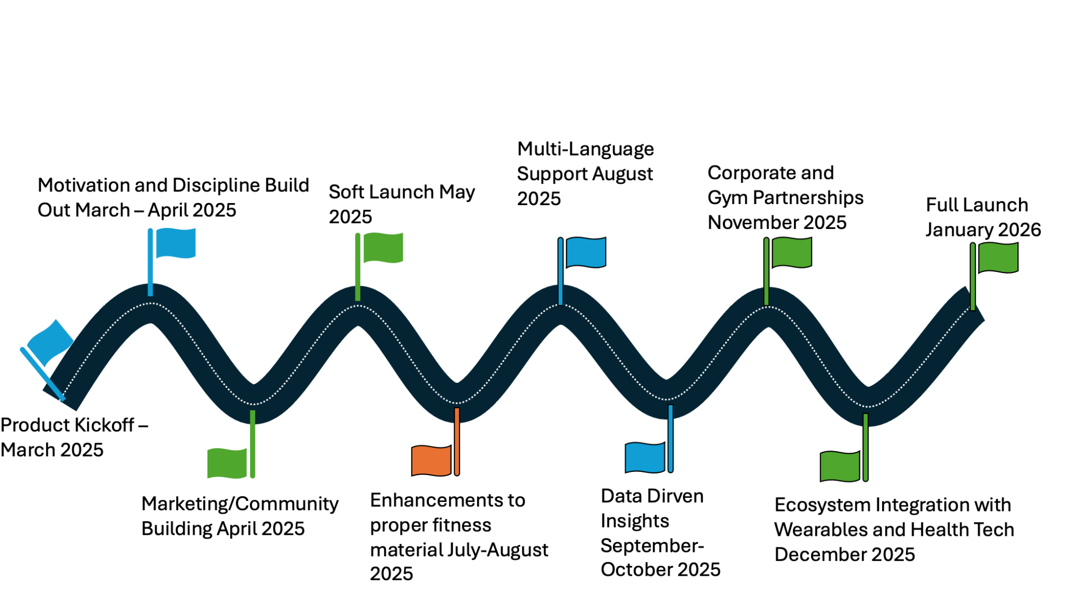
Project Timeline
Notes:
Avi: March – May 2025 – We kick off development, focusing on habit-building features while launching early marketing and community-building efforts. A soft launch in May allows early adopters to test and refine the experience.
✅ July – October 2025 – We enhance fitness content and introduce Data-driven insights, ensuring users get personalized workout recommendations. In August, multi-language support expands our reach globally.
✅ November – December 2025 – We scale by forming corporate and gym partnerships while integrating with wearables and health tech, creating a seamless fitness-tracking experience.
✅ January 2026 – Peak Potential fully launches, delivering an AI-powered, habit-driven fitness platform designed for long-term engagement.

Slide 12
Project Timeline
V1 MVP (Q2-Q3 2025)
V-NEXT Q4 2025
V-LONG TERM Q1-Q3 2026
Community Engagement (Advanced) - June 2025
Cost Accessibility -May 2025
Exercise Routine creation
Workout Builder - July 2025
Video Demonstration - August 2025
Step Tracking - May 2025
Gamification Features - May 2025
Daily Fitness Quotes - March 2025
Memories (photo feature) - March 2025
Progress Tracking - March 2025
Notifications and reminders - March 2025
Exercise Search & Filtering - April 2025
Community engagement (basic) - April 2025
Advanced Analytics - December 2025
AI Accountability Coach - January 2026
AI-Powered suggestions - September 2025
Wearable integration December 2025
Notes:
Avi

Slide 13



GTM
Pre- Launch
Launch
Growth
Referral Program – “Accountability Partners”
Influencer & Micro-Creator Collaborations
Peak Potential Launch Event (Virtual & In-Person)
Paid Ads Targeting Fitness Enthusiasts
User Engagement & Gamification
Exclusive Partnerships with Gyms & Trainers
SEO-Optimized Fitness Content (Blog & YouTube)
AI-Driven Personalized Workout & Nutrition Plans
Social media set up
Beta Tester Recruitment & Early Access Waitlist
Campus Ambassador Program
Fitness Challenge for Early Adopters
Notes:
Avi :✅ Pre-Launch: "We start by building awareness—setting up social media, recruiting beta testers, and launching a Campus Ambassador Program to drive early adoption. We’ll also engage early users through a fitness challenge, creating excitement and accountability before launch."
✅ Launch: "At launch, we focus on community-driven growth—introducing an Accountability Partner referral program, collaborating with influencers & micro-creators, and hosting a Peak Potential launch event both virtually and in-person. We’ll also run targeted paid ads to attract fitness enthusiasts."
✅ Growth: "Post-launch, we scale through gamification & user engagement, forging exclusive partnerships with gyms & trainers, and leveraging SEO-optimized content on blogs & YouTube to increase organic reach. Finally, our AI-driven personalized workout & nutrition plans will enhance user retention and long-term value."
🎯 "With this strategy, we’re not just launching a product—we’re building a movement that keeps users engaged and accountable. Next, let’s dive into our business model and monetization strategy!"

Slide 14

Notes:
Avi: Thank you all so much for listening to our presentation today. We believe fitness isn’t just about working out—it’s about consistency, progress, and having the right tools to succeed. And with Peak Potential, we’re giving people those tools. Let’s Build the New You Together. Thank you!

